Slide 1
Chapter 09 Nonlinear Least-squares
Prof. Lin ZHANG
School of Computer Science and Technology
Tongji University

Slide 2

Why is least squares an important problem?
In engineering fields, some mathematical terminologies are often met
Hessian matrix
Jacobian matrix
Damped method
Homogeneous linear equation system
Trust-region method
Damped Newton method
Inhomogeneous linear equation system
Gauss-Newton method
Lagrange multiplier
Levenberg-Marquardt method
Line search
Dog-leg method
Steepest descent method
Newton method

Slide 3
Outline
Non-linear Least Squares
General Methods for Non-linear Optimization
Basic Concepts
Descent Methods
Non-linear Least Squares Problems

Slide 4
Basic Concepts
Definition 1: Local minimizer
Given .
Find so that
where is a small positive number

Slide 5
Basic Concepts
Assume that the function F is differentiable and so smooth that the Taylor expansion is valid,
where is the gradient and is the Hessian,
,

Slide 6
Basic Concepts
Assume that the function F is differentiable and so smooth that the Taylor expansion is valid,
where is the gradient and is the Hessian,
It is easy to verify that,

Slide 7
Basic Concepts
Theorem 1: Necessary condition for a local minimizer
If is a local minimizer, then
Definition 2: Stationary point
If ,
then is said to be a stationary point for F.
A local minimizer (or maximizer) is also a stationary point. A stationary point which is neither a local maximizer nor a local minimizer is called a saddle point

Slide 8
Basic Concepts
Theorem 2: Sufficient condition for a local minimizer
Assume that is a stationary point and that is positive definite, then
is a local minimizer
If is negative definite, then is a local maximizer. If is indefinite (ie. it has both positive and negative eigenvalues), then is a saddle point

Slide 9
Outline
Non-linear Least Squares
General Methods for Non-linear Optimization
Basic Concepts
Descent Methods
Non-linear Least Squares Problems

Slide 10
Descent Methods
All methods for non-linear optimization are iterative: from a starting point the method produces a series of vectors which (hopefully) converges to
The methods have measures to enforce the descending condition,
For descent methods, in each iteration, we need to
Figure out a suitable descent direction to update the parameter
Find a step length giving good decrease in the F value
Thus, these kinds of methods are referred to as “descent methods”

Slide 11
Descent Methods
Consider the variation of the F-value along the half line starting at x and with direction h,
for sufficiently small
Definition 3: Descent direction
h is a descent direction for F at x if

Slide 12
Descent Methods
Descent Methods
2-phase methods
(direction and step length are determined in 2 phases separately)
1-phase methods
(direction and step length are determined jointly)
Trust region methods
Damped methods
Ex: Damped Newton method
Phase I
Phase II
Methods for computing descent direction
Steepest descent method
Newton’s method
SD and Newton hybrid
Methods for computing the step length
Line search

Slide 13
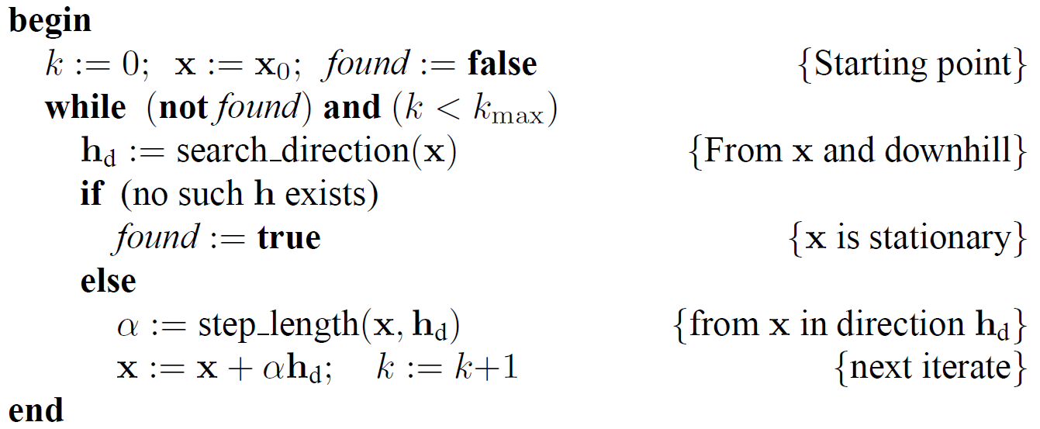
2-phase methods: General Algorithm Framework
Algo#1: 2-phase Descent Method (a general framework )

Slide 14
2-phase methods: steepest descent to compute the descent direction
When we perform a step with positive , the relative gain in function value satisfies,
where is the angle between vectors and
This shows that we get the greatest relative gain when , i.e., we use the steepest descent direction h_{sd} given by
This is called the steepest gradient descent method

Slide 15
2-phase methods: steepest descent to compute the descent direction
Properties of the steepest descent methods
The choice of descent direction is “the best” (locally) and we could combine it with an exact line search
A method like this converges, but the final convergence is linear and often very slow
For many problems, however, the method has quite good performance in the initial stage of the iterative; Considerations like this have lead to the so-called hybrid methods, which – as the name suggests – are based on two different methods. One of which is good in the initial stage, like the gradient method, and another method which is good in the final stage, like Newton’s method

Slide 16
2-phase methods: Newton’s method to compute the descent direction
Newton’s method is derived from the condition that x* is a stationary point, i.e.,
From the current point x, along which direction moves how far (a vector h_{n}), will it be most possible to arrive at a stationary point? I.e., we solve h_{n} from,
what is the solution to h_{n}?

Slide 17
2-phase methods: Newton’s method to compute the descent direction
So h_{n} is the solution to,
Suppose that is positive definite, then,
i.e.,
indicates that is a descent direction
In classical Newton method, the update is (then it can be regarded as a 1-phase method),
x:=x+h_{n}
However, in most modern implementations,
x:=x+αh_{n}
where α is determined by line search

Slide 18
2-phase methods: Newton’s method to compute the descent direction
Properties of the Newton’s method
Newton’s method is very good in the final stage of the iteration, where x is close to x*
Only when is positive definite, it is sure that h_{n} is a descent direction
So, we can build a hybrid method, based on Newton’s method and the steepest descent method,
In Algo#1, we can use a hybrid method to get the descent direction
if is positive definite
else

Slide 19
2-phase methods: General Algorithm Framework
Algo#1: 2-phase Descent Method (a general framework )

Slide 20
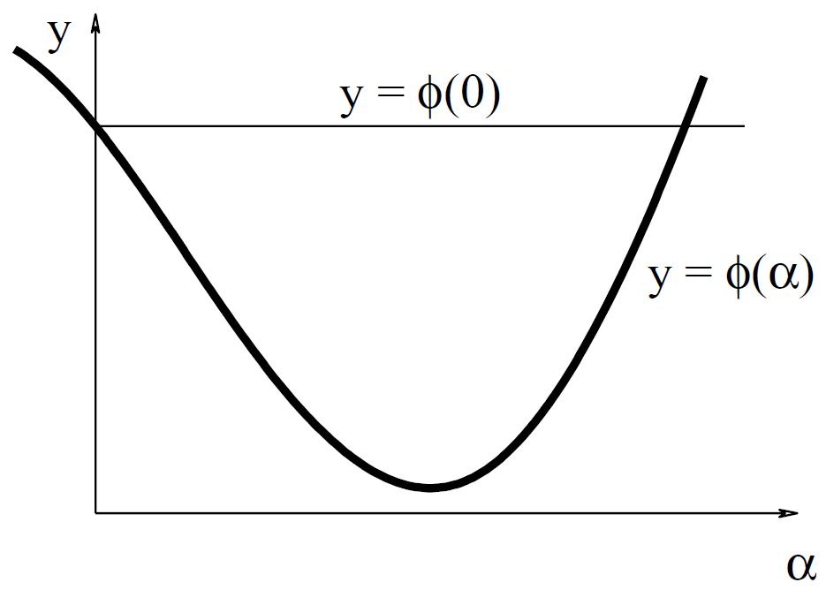
2-phase methods: Line search to find the step length
Given a point x and a descent direction h. The next iteration step is a move from x in direction h. To find out, how far to move, we study the variation of the given function along the half line from x in the direction h,
, x and h are fixed,
Since h is a descent direction, when is small
An example of the behavior of ,
Variation of the function value along the search line

Slide 21
2-phase methods: Line search to find the step length
Line search to determine
is iterated from an initial guess, e.g., , then three different situations can arise
1. is so small that the gain in value of the function is very small;
should be increased
2. is too large:
should be decreased to satisfy the descent condition
3. is close to the minimizer of . Accept this value

Slide 22
Descent Methods
Descent Methods
2-phase methods
(direction and step length are determined in 2 phases separately)
1-phase methods
(direction and step length are determined jointly)
Trust region methods
Damped methods
Ex: Damped Newton method
Phase I
Phase II
Methods for computing descent direction
Steepest descent method
Newton’s method
SD and Newton hybrid
Methods for computing the step length
Line search

Slide 23
1-phase methods: approximation model for F
Both trust region and damped methods assume that we have a model L of the behavior of F in the neighborhood of the current iterate x,
where and is symmetric
For example, the model can be a second order Taylor expansion of F around x

Slide 24
1-phase methods: trust region method
In a trust region method we assume that we know a positive number such
that the model is sufficiently accurate inside a ball with radius , centered
at x, and determine the step as
Usually, we do not need to solve Eq. (1); instead, we can compute h_{tr} in an approximation way, such as Dog Leg method
(Eq.1)
Note that: h_{tr} consists of two parts of information, the direction and the step length
So, basic steps to update using a trust region method are,
compute h by (1)
if F(x+h)<F(x)
x:=x+h
update
the core problem

Slide 25
1-phase methods: trust region method
For each iteration, we modify
If the step fails, the reason is is too large, and should be reduced
If the step is accepted, it may be possible to use a larger step from the new iterate
The quality of the model with the computed step can be evaluated by the gain ratio,
Definition 4: Gain ratio
the actual decrease
the predicted decrease
This part is constructed to be positive. Why?

Slide 26
1-phase methods: trust region method
If is small, indicating that the step is too large
If is large, meaning that the approximation of L to F is good and we can try an even larger step
Algo#2 The updating strategy for trust region radius
if
elseif

Slide 27
Descent Methods
Descent Methods
2-phase methods
(direction and step length are determined in 2 phases separately)
1-phase methods
(direction and step length are determined jointly)
Trust region methods
Damped methods
Ex: Damped Newton method
Phase I
Phase II
Methods for computing descent direction
Steepest descent method
Newton’s method
SD and Newton hybrid
Methods for computing the step length
Line search

Slide 28
1-phase methods: damped method
In a damped method the step is determined as,
(Eq. 2)
where is the damping parameter. The term is used to penalize large steps.
The step h_{dm} is computed as a stationary point for the function,
Indicating that h_{dm} is a solution to,

Slide 29
1-phase methods: damped method
(Eq. 3)
In a concrete algorithm, B+µI is usually constructed to be positive definite
When B+µI is positive definite, L(h)+1/2µh^{T}h actually is a (strictly) convex function, so its stationary point -(B+µI)⁻¹c is the global minimizer

Slide 30
1-phase methods: damped method
So, basic steps to update using a damped method are (similar to the trust region method),
Algo#3 Basic steps using a damped method
compute h by Eq. 2
if F(x+h)<F(x)
x:=x+h
update
the core problem

Slide 31
1-phase methods: damped method
If is small, we should increase and thereby increase the penalty on large steps
If is large, indicating that L(h) is a good approximation to F(x+h) for the computed h, and may be reduced
Algo#4
Algo#5
The 1st updating strategy for
The 2nd updating strategy for
if
if
elseif
else
(Marquart 1963)
(Nielsen 1999)

Slide 32
1-phase methods: damped method
Ex: Damped Newton method
where and is symmetric
if and
(Eq. 3) takes the form,
the so-called damped Newton step
If is very large,
, a short step in a direction close to the deepest descent direction
If is very small,
, a step close to the Newton step
We can think of the damped Newton method as a hybrid between the steepest descent method and the Newton method

Slide 33
Outline
Non-linear Least Squares
General Methods for Non-linear Optimization
Non-linear Least Squares Problems
Basic Concepts
Gauss-Newton Method
Levenberg-Marquardt Method
Powell’s Dog Leg Method

Slide 34
Basic Concepts
Formulation of non-linear least squares problems
Non-linear least squares problems can be solved by general optimization methods, which will have some specific forms in this special case
Given a vector function
We want to find,
where,

Slide 35
Basic Concepts
Taylor expansion for ,
(Eq. 4)
is called the Jacobian matrix of f(x)

Slide 36
Basic Concepts

Slide 37
Basic Concepts
(Eq. 5)

Slide 38
Basic Concepts
(addition of a stack of matrices)

Slide 39
Outline
Non-linear Least Squares
General Methods for Non-linear Optimization
Non-linear Least Squares Problems
Basic Concepts
Gauss-Newton Method
Levenberg-Marquardt Method
Powell’s Dog Leg Method

Slide 40
Gauss-Newton Method
The Gauss-Newton method is based on a linear approximation to the components of f (a linear model of f) in the neighborhood of x (refer to Eq. 4),
We suppose J has full column rank
The Gauss-Newton step h_{gn} minimizes L(h),
h_{gn} is the solution to,
It can be considered that the Gauss-Newton’s updating step is obtained by using the trust-region method with ∆=inf, or by the damped method with µ=0 (compare with Eq. 3)

Slide 41
Gauss-Newton Method
Some notes about Gauss-Newton methods
The classical Gauss-Newton method uses in all steps, then it can be regarded as a 1-phase method)
We can use h_{gn} for h_{d} in Algo#1.
Solve

Slide 42
Gauss-Newton Method
Some notes about Gauss-Newton methods
The classical Gauss-Newton method uses in all steps, then it can be regarded as a 1-phase method)
If is elegantly searched by line search, it can be categorized as a 2-phase method
We can use h_{gn} for h_{d} in Algo#1.
Solve
where is obtained by line search

Slide 43
Gauss-Newton Method
Some notes about Gauss-Newton methods
The classical Gauss-Newton method uses in all steps, then it can be regarded as a 1-phase method)
If is elegantly searched by line search, it can be categorized as a 2-phase method
For each iteration step, it requires that the Jacobian J has full column rank
If J has full column rank, J^{T}J is positive definite
Proof:
J has full column rank J’s columns are linearly unrelated
J^{T}J is positive definite

Slide 44
Outline
Non-linear Least Squares
General Methods for Non-linear Optimization
Non-linear Least Squares Problems
Basic Concepts
Gauss-Newton Method
Levenberg-Marquardt Method
Powell’s Dog Leg Method

Slide 45
Levenberg-Marquardt Method
L-M method can be considered as a damped Gauss-Newton method
Consider a linear approximation to the components of f (a linear model of f) in the neighborhood of x,
We don’t require J has full column rank
Based on damped method (refer to Eq. 2),
, where is the damped coefficient
h_{lm} is the solution to,
positive definite

Slide 46
Levenberg-Marquardt Method
Let , then is positive definite for
Proof:
is positive semi-definite
All A’s eigen-values
I.e., all ’s eigen-values
is positive definite

Slide 47
Levenberg-Marquardt Method
L-M method can be considered as a damped Gauss-Newton method
L-M’s step:
Gauss-Newton’s step (if ):
That’s why we say L-M is a damped Gauss-Newton method

Slide 48
Levenberg-Marquardt Method
Updating strategy of
influences both the direction and the size of the step, and this leads L-M without a specific line search
The initial –value is related to the elements in by letting,
During iteration, can be updated by Algo#4 or Algo#5

Slide 49
Levenberg-Marquardt Method
Stopping criteria
For a minimizer x*, ideally we will have
If for the current iteration, the change of x is too small,
Finally, we need a safeguard against an infinite loop,
So, we can use
as the first stopping criterion
where k is the current iteration index

Slide 50
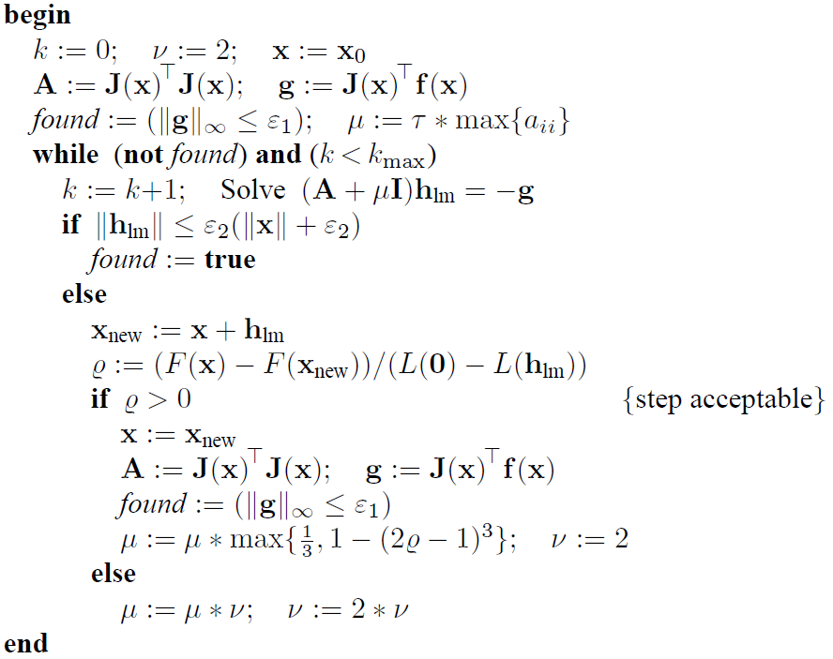
Levenberg-Marquardt Method
Algo#6: L-M Method
g actually is F'(x), see Eq. 5

Slide 51
Outline
Non-linear Least Squares
General Methods for Non-linear Optimization
Non-linear Least Squares Problems
Basic Concepts
Gauss-Newton Method
Levenberg-Marquardt Method
Powell’s Dog Leg Method

Slide 52

Powell’s Dog Leg Method
It works with combinations with the Gauss-Newton and the steepest descent directions
It is a trust-region based method
Powell is a keen golfer!
Michael James David Powell (29 July 1936 – 19 April 2015) was a British mathematician, who worked at the University of Cambridge

Slide 53
Powell’s Dog Leg Method
Gauss-Newton step
The steepest descent direction
This is the direction, not a step, and to see how far we should go, we look at the linear model,
This function of is minimal for,
(Eq. 6)

Slide 54
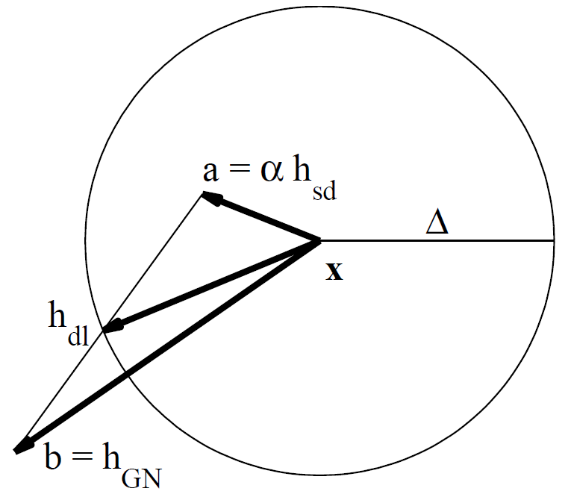
Powell’s Dog Leg Method
Now, we have two candidates for the step to take from the current point x,
Powell suggested to use the following strategy for choosing the step, when the trust region has the radius
Algo#6
if
elseif
the last case
else
with chosen so that

Slide 55
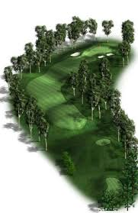
Powell’s Dog Leg Method
The name Dog Leg is taken from golf: The fairway at a “dog leg hole” has a shape as the line from x (the tee point) via the end point of a to the end point of h_{dl} (the hole)
Dog Leg hole

Slide 56
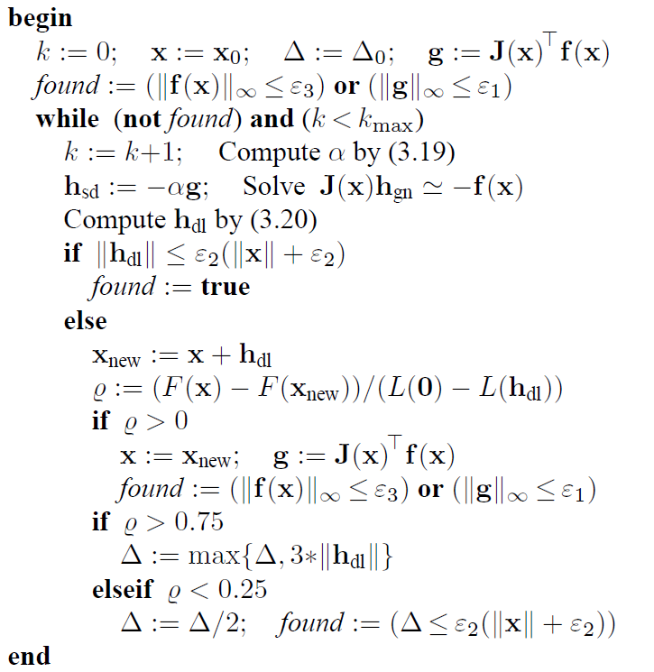
Powell’s Dog Leg Method
Algo#7: Dog Leg Method
(Eq. 6)
(Algo# 6)

Slide 57


